Slide 1
Testing and modeling users
Syed Ahmed Shah (19SW44)
Your Logo
Notes:
© Copyright PresentationGO.com – The free PowerPoint template library

Slide 2
User Testing
Software being developed relates to the user needs.
It focuses on number of errors while performing a task.
Users are able to perform their intended tasks.
Goals and Questionnaires helping user in task completion.
Your Logo
Notes:
© Copyright PresentationGO.com – The free PowerPoint template library

Slide 3
Usability Testing
Software Product is easy to use.
How much time it takes for a new user to learn it.
The product provides error free environment.
How frequently a user uses an app.
Example: There are a lot of Media players but a user prefers one, which is very responsive and easy to use i.e vlc media player.
Your Logo
Notes:
© Copyright PresentationGO.com – The free PowerPoint template library

Slide 4
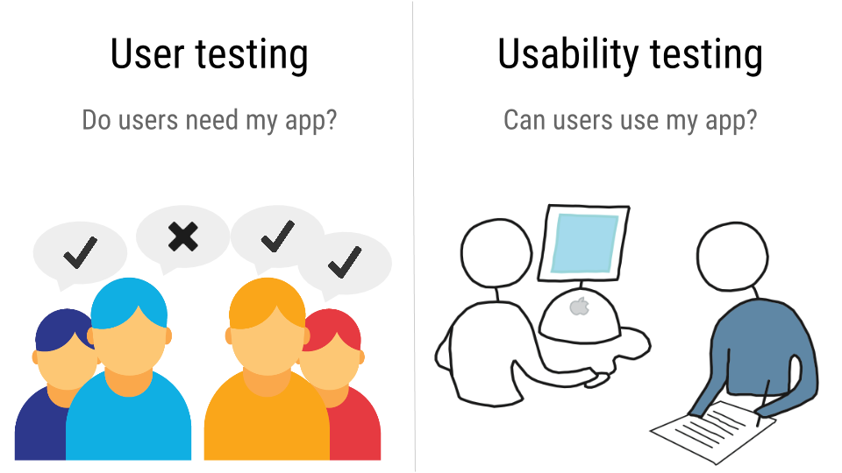

Slide 5
Testing Conditions
A space is required where testing can be performed.
Major focus is on selecting users for performing tasks.
Developing tasks for the users to perform.
5-10 users should be selected.
All users should be provided with same conditions or the tasks.
Your Logo
Notes:
© Copyright PresentationGO.com – The free PowerPoint template library

Slide 6
Usability measures
Time
Errors
Users
Success Rate
Time to complete a task.
Number and type of errors per task.
Number of errors per unit of time.
Number of users making a particular error.
Number of users completing a task successfully.
*PowerPoint SmartArt graphic
Notes:
© Copyright PresentationGO.com – The free PowerPoint template library

Slide 7
Usability Engineering Orientation
Current level of performance.
Minimum intended level of performance.
Target level of performance.

Slide 8
G.O.M.S
Goals : what the user wants to achieve by using our system.
E.g : Write and save text files
Operators : through what functions/actions are the goals achieved.
E.g. : which text editor to use
Methods : what procedures/methods are used to achieve the goals
Select icon by clicking with mouse button
Make text bold by using ctrl+B
etc.
Selections : how/why is one method selected over another method
Using the shortcut ctrl+b is easier and faster than selecting than BOLD icon

Slide 9
Thankyou
Notes:
© Copyright PresentationGO.com – The free PowerPoint template library

